Slide 1

March 26, 2024
Congjian Wang
Platform of Optimal Experiment Management
(POEM)

Slide 2
Tool: Optimal Experimental Design Platform
Optimal experimental design platform powered with automated machine learning to accelerate the discovery of optimal solutions, and automatically guide the design of experiment to be evaluated.
Randomized model exploration to better understand experimental domain
Machine learning models aided experimental domain exploration, such as Gaussian Process model and Gaussian Polynomial Chaos model
Sparse Grid for high-dimensional model representation (HDMR) to accelerate experimental design
Variance-based sensitivity analysis
Cooperative/interaction effects between variables
Dynamic sensitivity and uncertainty analysis
Optimal experimental design via Bayesian Optimization
Design parameter optimization via Bayesian Optimization
Model calibration through Bayesian inference

Slide 3
ROM and Suggestions via Bayesian Optimization
Utilize Bayesian optimization structure to exploit the experimental space
Exploit and explore
Bayesian Optimization
Experimental data
Machine learning
Acquisition function
Best sample
Evaluate simulation
Gaussian process
Probability of improvement
Expected improvement
Upper confidence bound
High-fidelity model
Inner evaluations
Evaluate experiments
Proposed best experiments
Outer evaluations

Slide 4
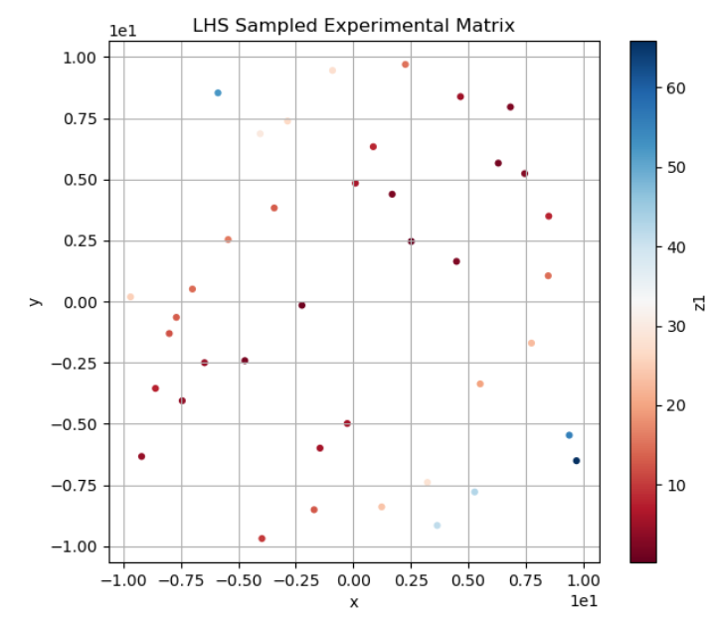
Randomized Model Exploration

Slide 5
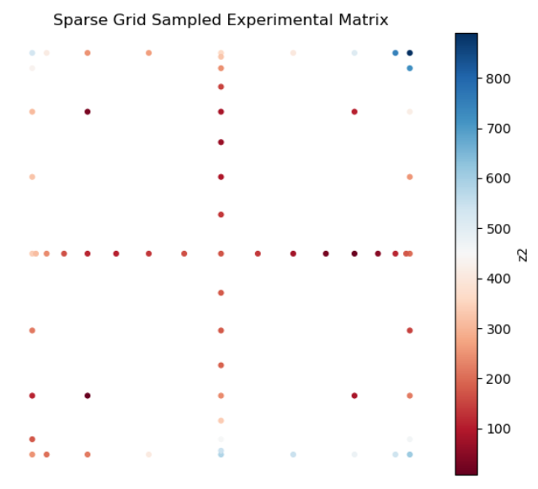
Sparse Grid to accelerate experimental design

Slide 6
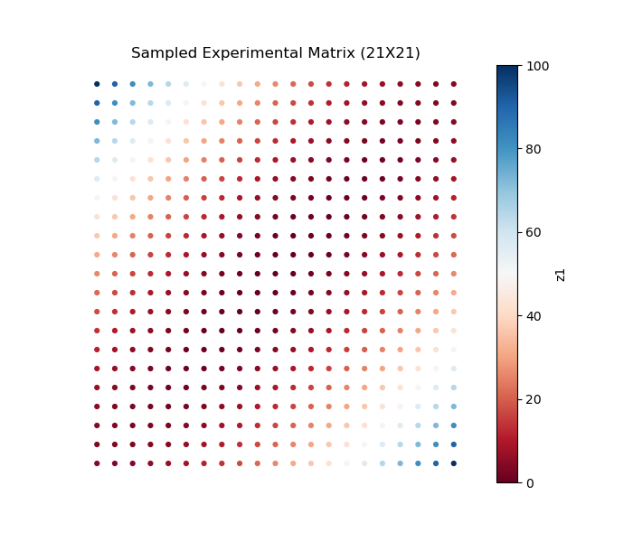
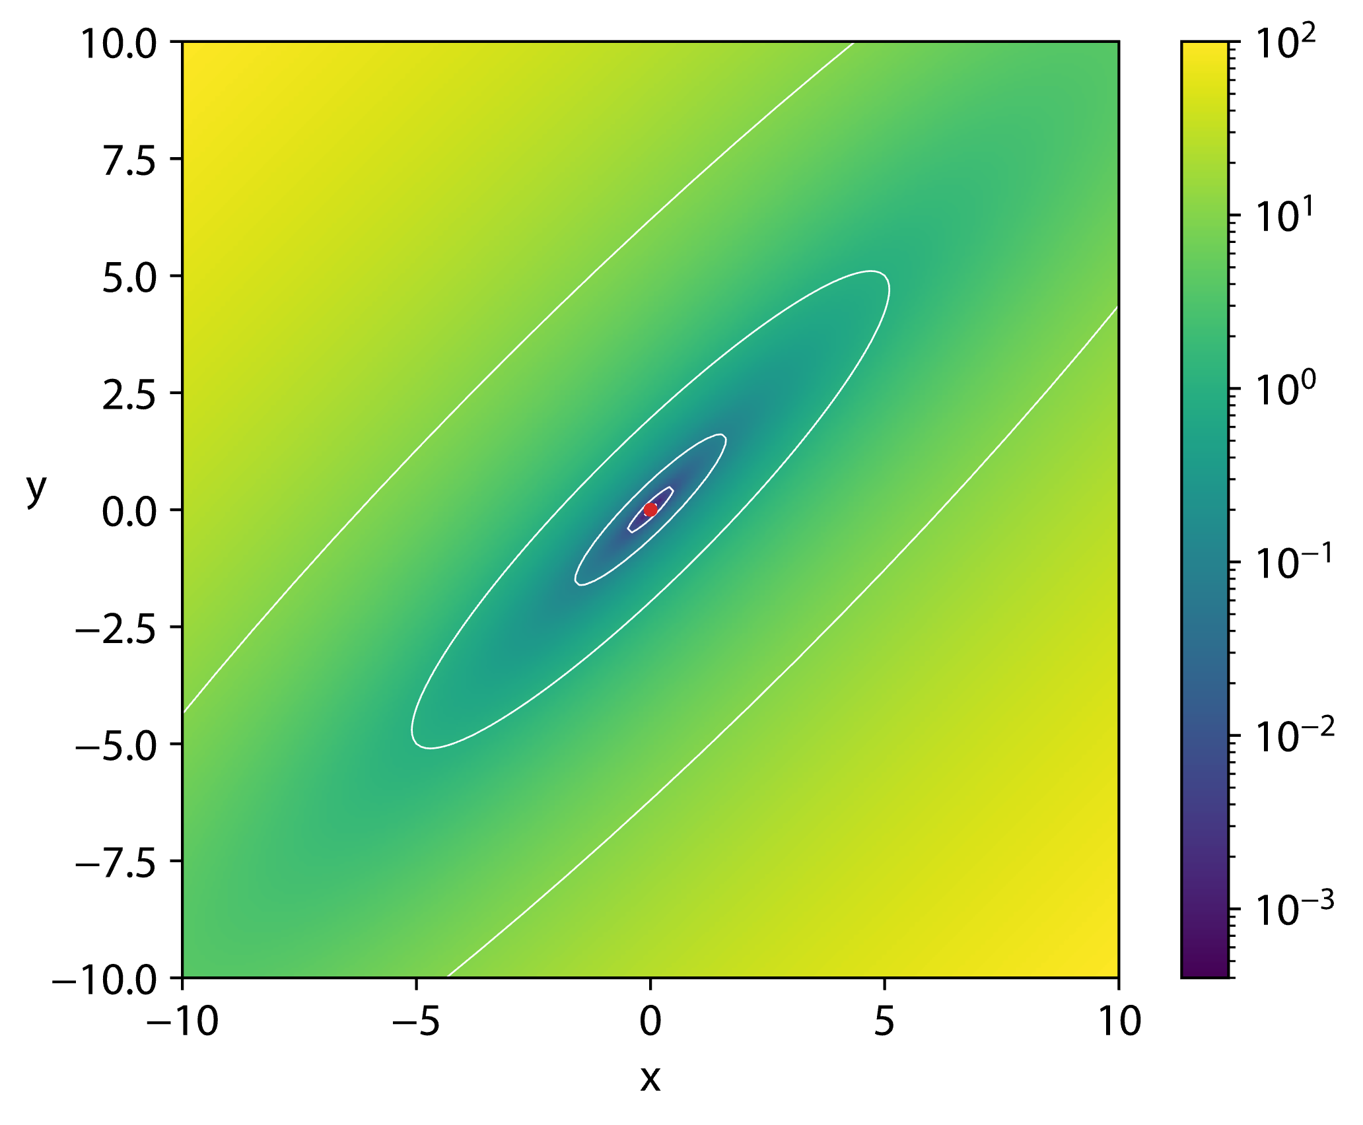
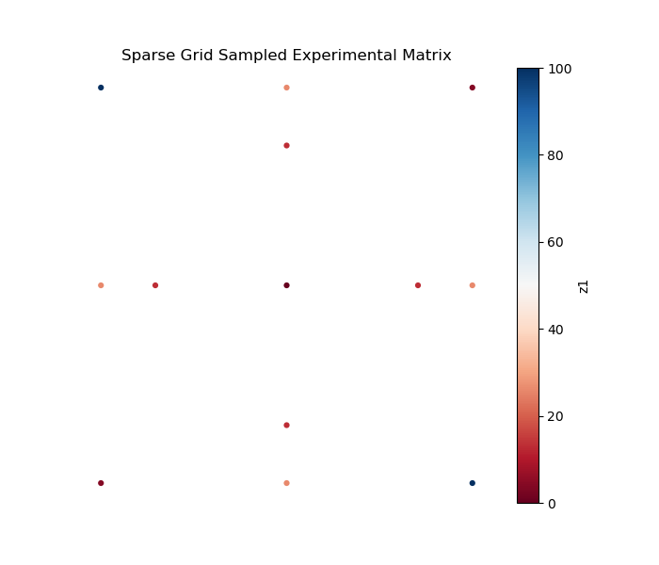
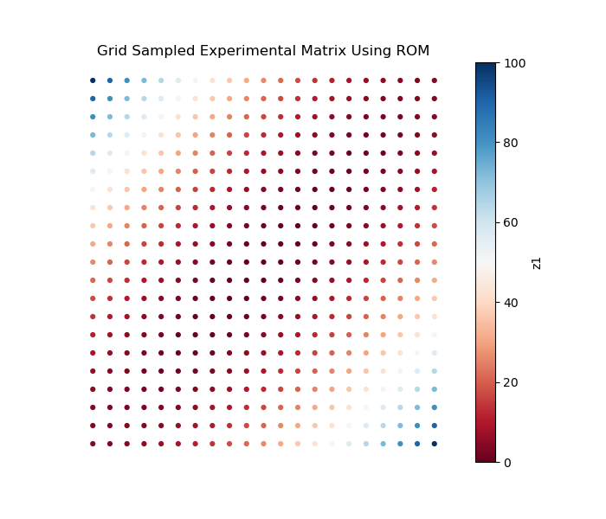
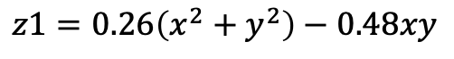
Accelerate Experimental Design: Matyas Function
$$z1=0.26\left(x^{2}+y^{2}\right)−0.48xy$$
High-Fidelity Simulation
Grid
Sampling
ROM Simulation
Sparse Grid Collocation
Generalized Polynomial Chaos
ROM
Simulation data at sparse grid locations
Conduct experiment at sparse grid locations
Combine both data for ROM construction
Grid
Sampling

Slide 7
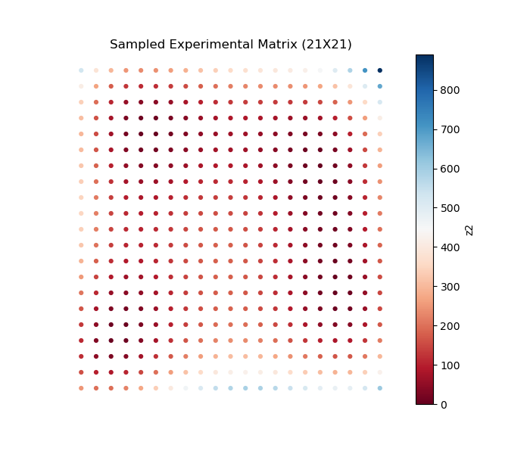
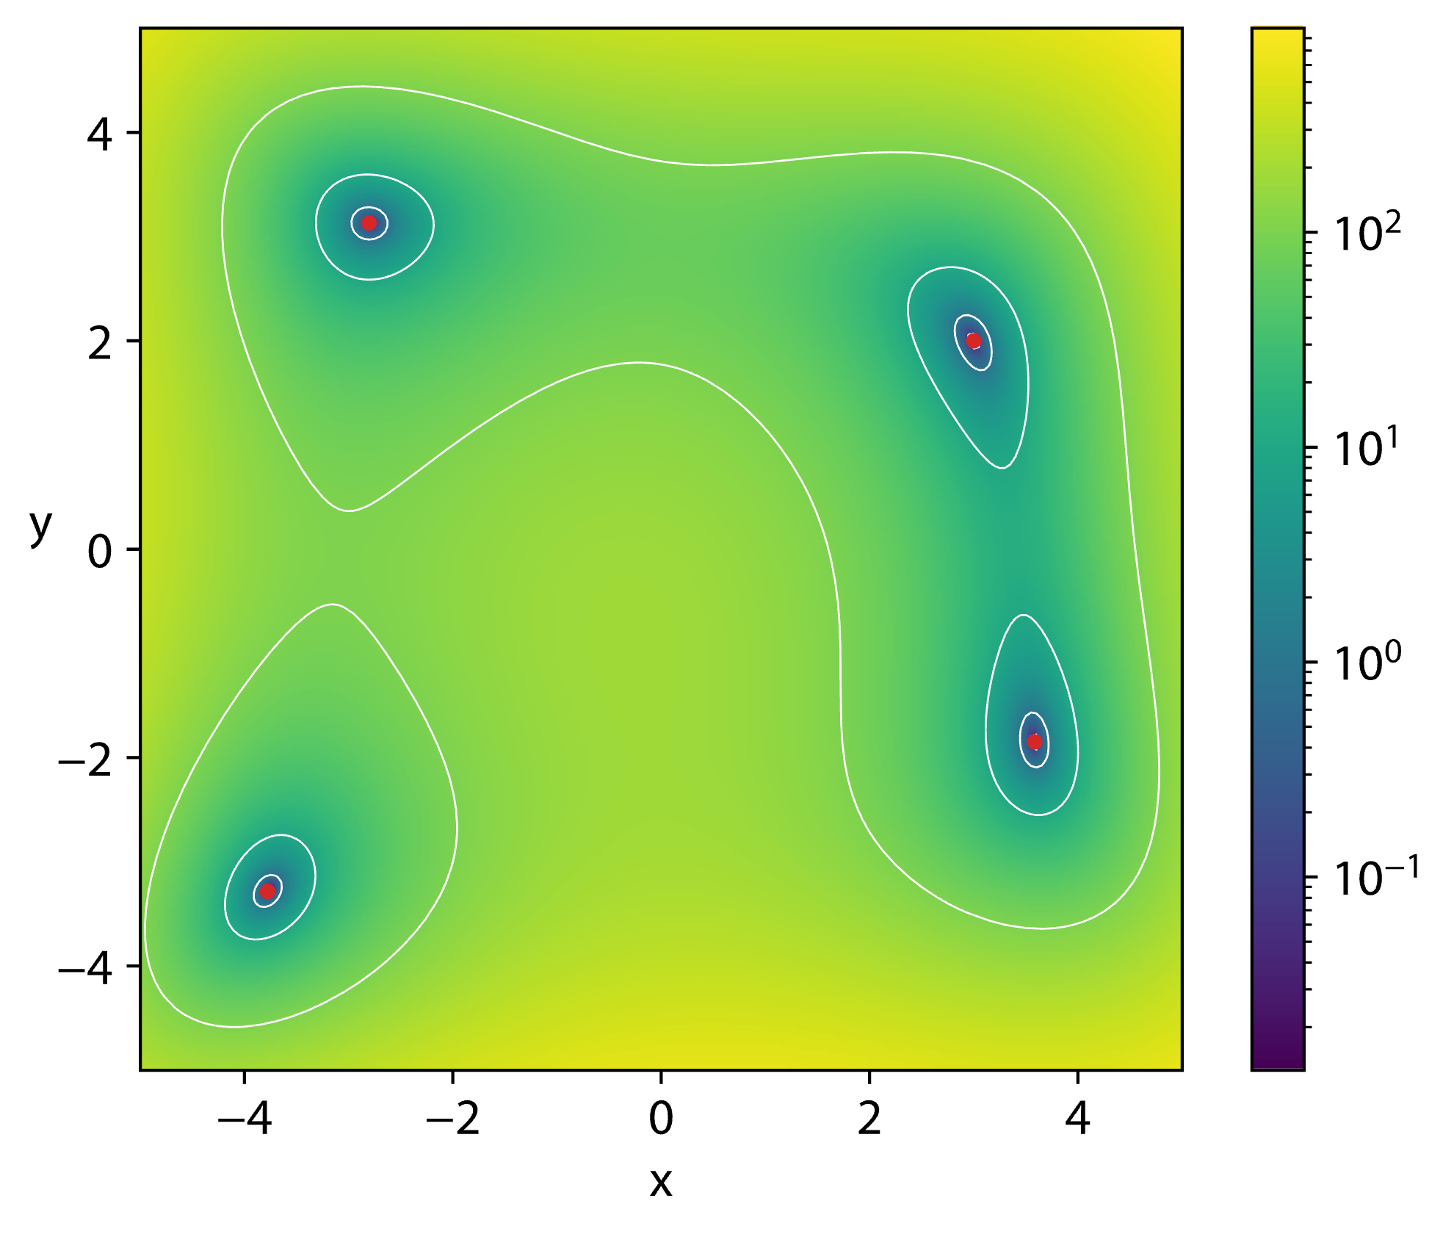
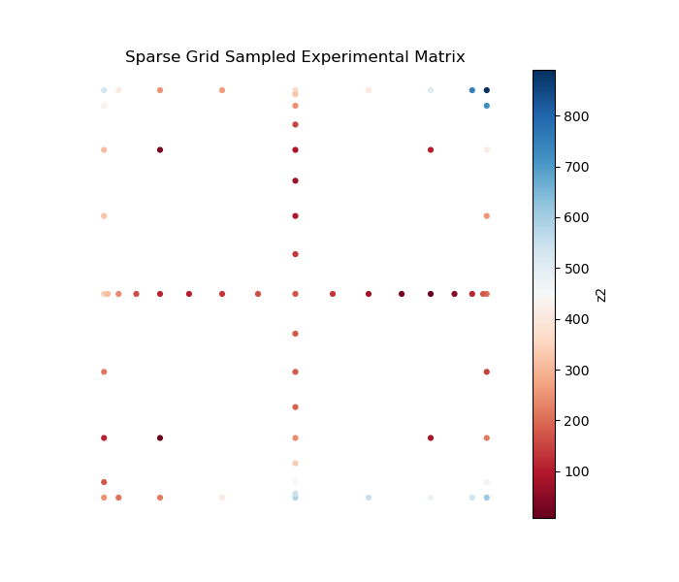
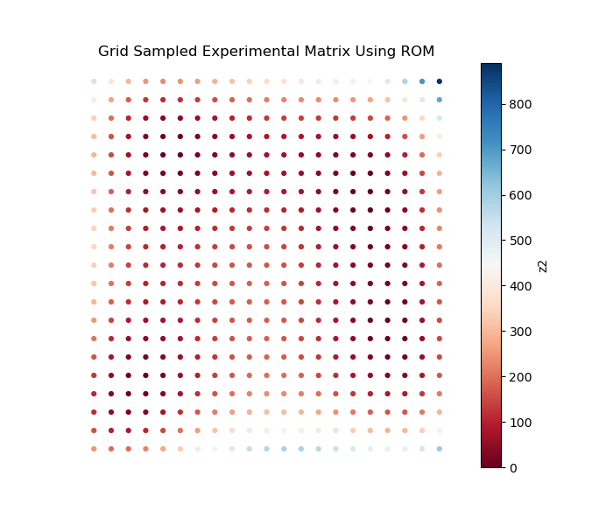
Accelerate Experimental Design: Himmelblau Function
$$z2={\left(x^{2}+y−11\right)}^{2}+{\left(x+y^{2}−7\right)}^{2}$$
High-Fidelity Simulation
Grid
Sampling
ROM Simulation
Sparse Grid Collocation
Generalized Polynomial Chaos
ROM
Simulation data at sparse grid locations
Conduct experiment at sparse grid locations
Combine both data for ROM construction
Grid
Sampling

Slide 8
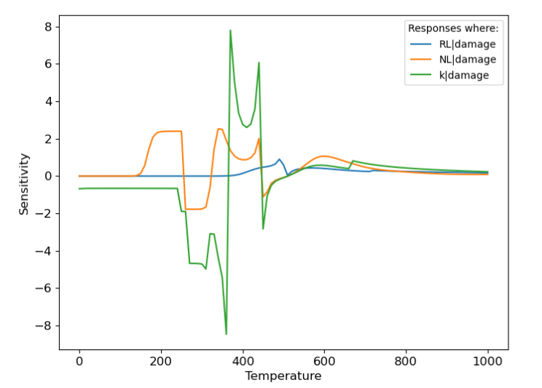
Dynamic sensitivity and uncertainty analysis

Slide 9
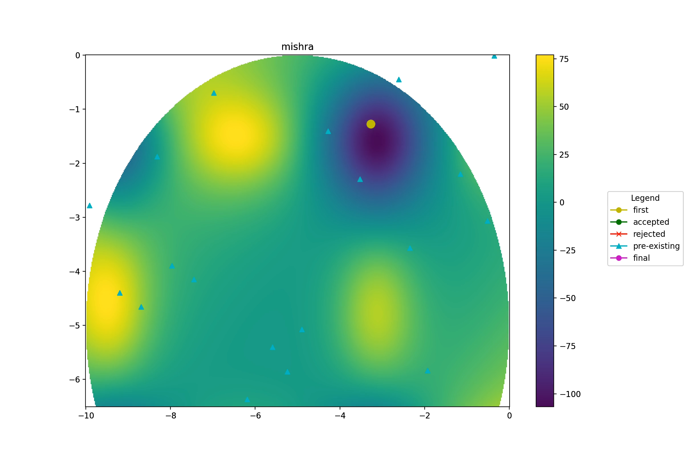
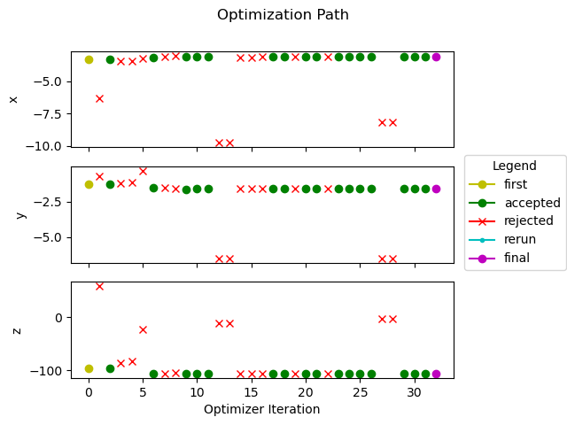
Bayesian Optimization with Constraints

Slide 10
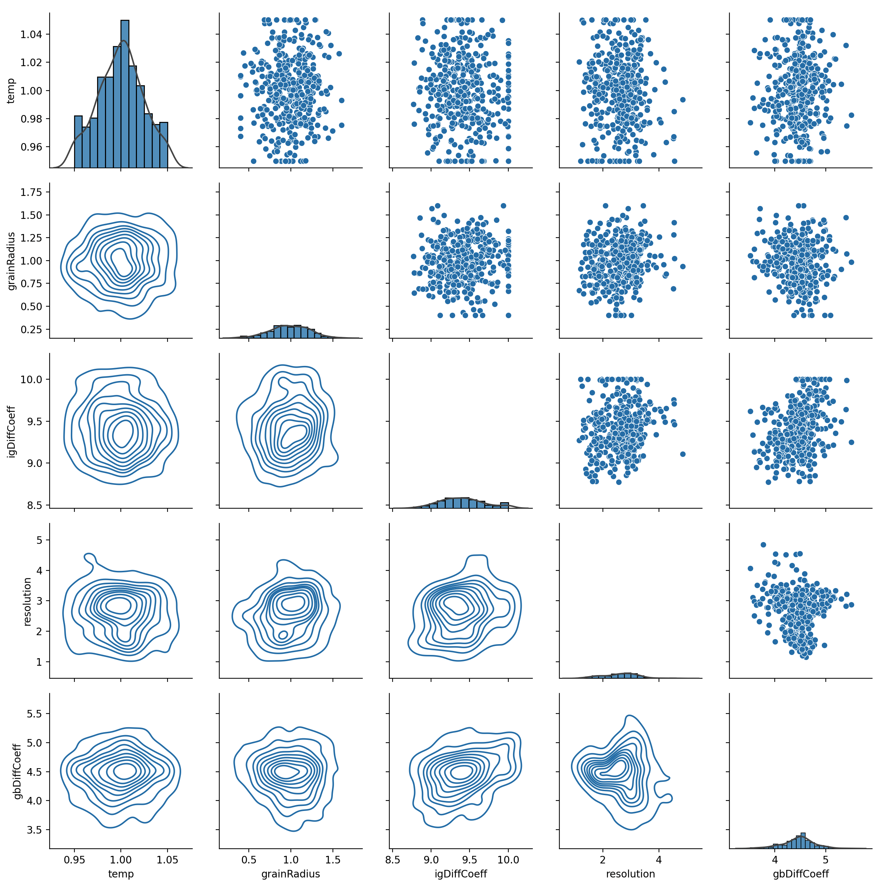
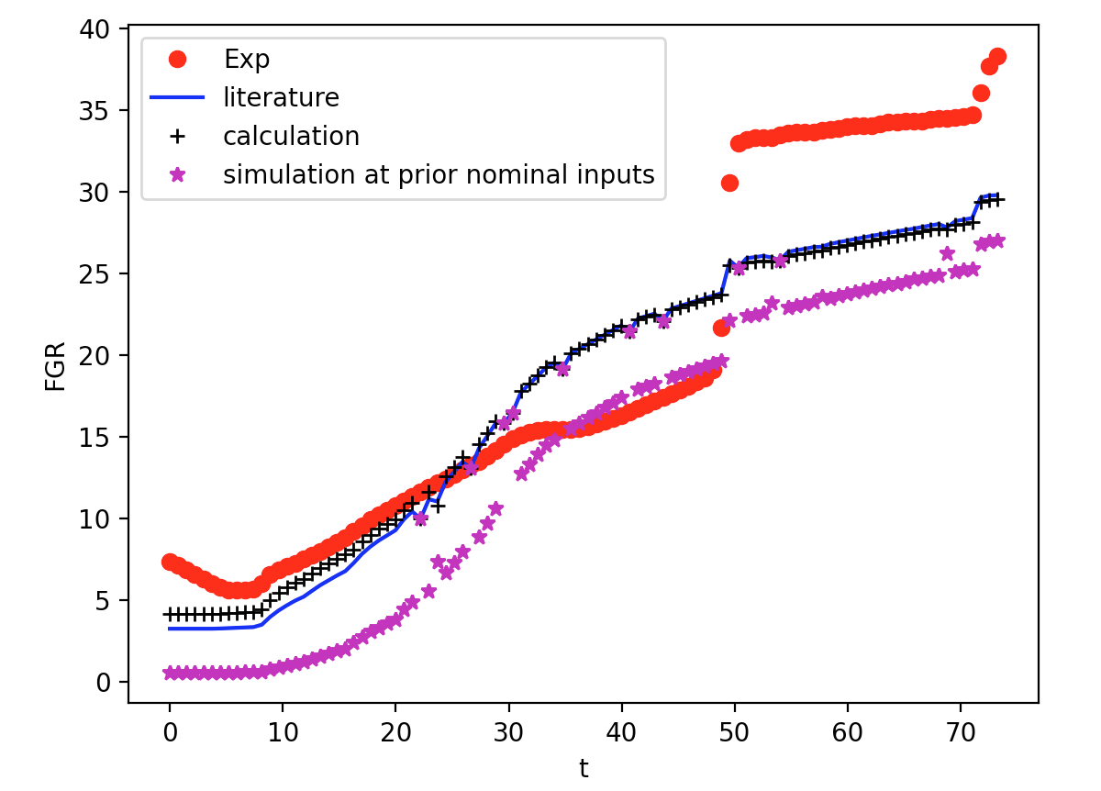
Model Calibration: Fission Gas Release Model

Slide 11
POEM DEMO

Slide 12
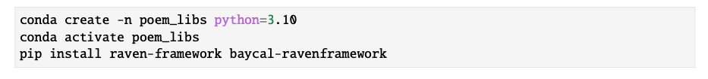
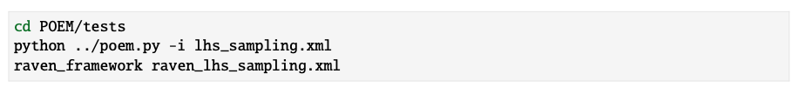

Installation and Testing
Installation
Testing
Documentation

Slide 13
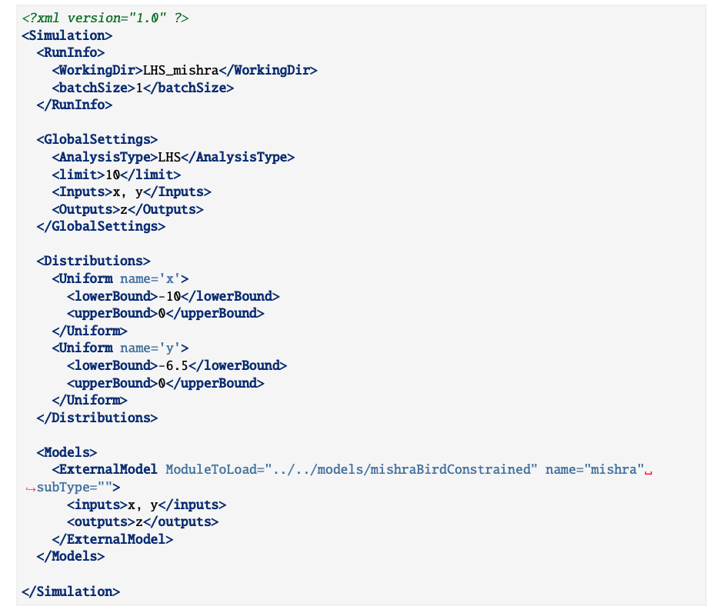
Example

Slide 15
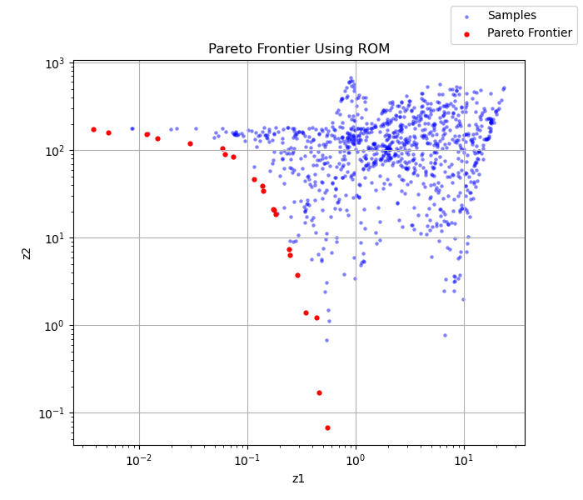
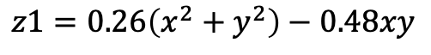
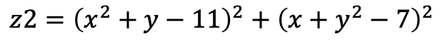
Accelerate Experimental Design: Pareto Frontier
$$z2={\left(x^{2}+y−11\right)}^{2}+{\left(x+y^{2}−7\right)}^{2}$$
$$z1=0.26\left(x^{2}+y^{2}\right)−0.48xy$$

Slide 16
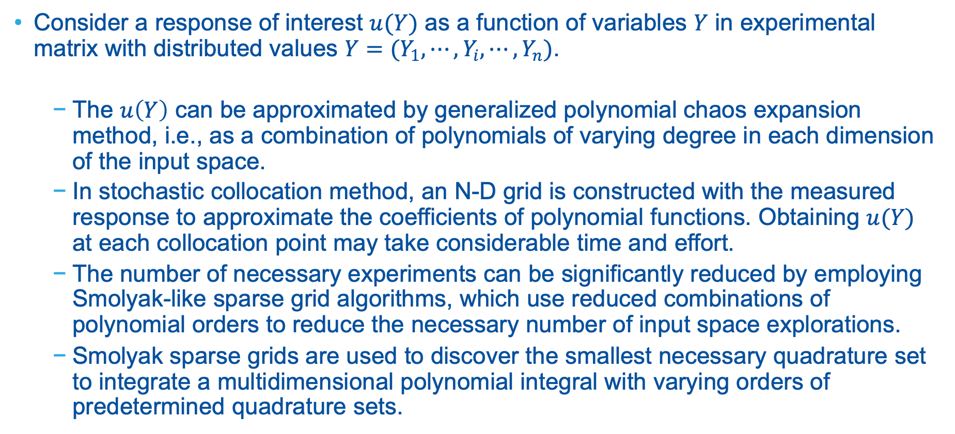
Accelerate DOE via Sparse Grid Stochastic Collocation
Consider a response of interest $u(Y)$ as a function of variables $Y$ in experimental matrix with distributed values $Y=(Y_{1},⋯,Y_{i},⋯,Y_{n})$.
The $u\left(Y\right)$ can be approximated by generalized polynomial chaos expansion method, i.e., as a combination of polynomials of varying degree in each dimension of the input space.
In stochastic collocation method, an N-D grid is constructed with the measured response to approximate the coefficients of polynomial functions. Obtaining $u(Y)$ at each collocation point may take considerable time and effort.
The number of necessary experiments can be significantly reduced by employing Smolyak-like sparse grid algorithms, which use reduced combinations of polynomial orders to reduce the necessary number of input space explorations.
Smolyak sparse grids are used to discover the smallest necessary quadrature set to integrate a multidimensional polynomial integral with varying orders of predetermined quadrature sets.

Slide 17
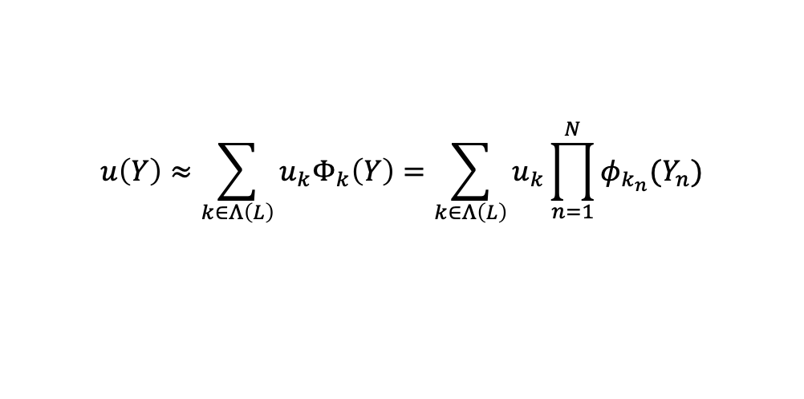
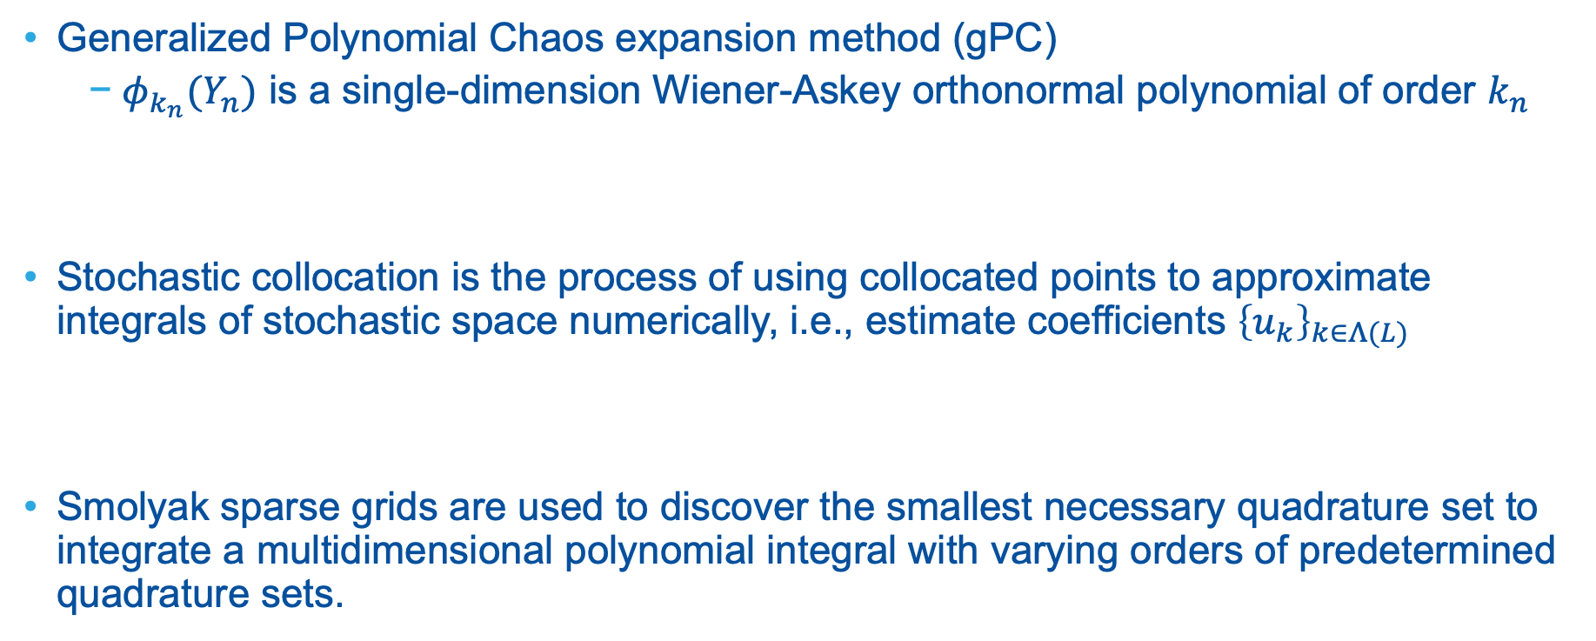

Accelerate DOE via Sparse Grid Stochastic Collocation
Generalized Polynomial Chaos expansion method (gPC)
$φ_{k_{n}}(Y_{n})$ is a single-dimension Wiener-Askey orthonormal polynomial of order $k_{n}$
Stochastic collocation is the process of using collocated points to approximate integrals of stochastic space numerically, i.e., estimate coefficients ${\left\{u_{k}\right\}}_{k∈Λ(L)}$
Smolyak sparse grids are used to discover the smallest necessary quadrature set to integrate a multidimensional polynomial integral with varying orders of predetermined quadrature sets.
$$u\left(Y\right)≈\sum_{k∈Λ\left(L\right)}{u_{k}Φ_{k}\left(Y\right)}=\sum_{k∈Λ\left(L\right)}{u_{k}\prod_{n=1}^{N}{φ_{k_{n}}(Y_{n})}}$$
$$u_{k}=\frac{\left\langle u\left(Y\right){, Φ}_{k}(Y)\right\rangle }{\left\langle Φ_{k}\left(Y\right), Φ_{k}(Y)\right\rangle }$$

